Slide 1

Session 1
Ignite Dental Vision

Slide 2
Topic 1: Teeth whitening
Patient came with a complaint of discolored teeth and wants to get teeth whitening done. O/E – mild discoloration in anterior teeth.
Discuss the treatment. (PCC/Comm)
Informed consent (Comm)

Slide 3
Pointers
Gather History: Diet, smoking
Is anything in your mind regarding this concern---
Understand the expectations and perspective: , is she willing to spend time money immediate solution or not.
Procedure:
In office: Hydrogren perioxide 35%
Can provide immediate results. Safe and effective when performed under professional supervision
Expensive, Sensitivity
Alternative Option
Take-home whitening kits: custom tray with 10-15% carbamide peroxide or strips
Can be used for maintenance, Less expensive
A more gradual whitening effect. Compliance needed
Post op precautions
RISK: Inform about the possibility
Provide written information

Slide 4
Q 2: Temporomandibular diseases
Diagnosis
Management
Role as a General practitioner

Slide 5
Feature | Intra-Articular (Internal Derangement + Arthritis) | Extra-Articular (MPDS)
Predisposing factors | Joint injury, hypermobility, inflammatory arthritis, autoimmune disease, aging, prior trauma | Bruxism, clenching, abnormal posture, stress, fibromyalgia
Mandibular Movement | Deviation toward affected side, limited opening (<25 mm in closed lock); limited motion, stiffness (arthritis) | Normal or reduced opening due to muscle pain
Joint Sounds | Clicking (disk displacement); crepitus common in arthritis | None
Pain Location | TMJ tenderness, joint pain on loading, joint line tenderness | Muscle tenderness (masseter, temporalis, neck)
Palpation | Tender TMJ, reproducible tenderness, coarse crepitus (arthritis) | Tender masticatory muscles, neck muscles
Range of Motion | Limited, deviation; joint degeneration restricts motion | Limited due to muscle restriction
Other signs | Locking, sudden stop in opening (ID); joint stiffness, swelling (arthritis) | Headache, referred pain, neck stiffness
Psychosocial Factors | Minimal (internal derangement); variable (arthritis) | Significant role: anxiety, depression common

Slide 6
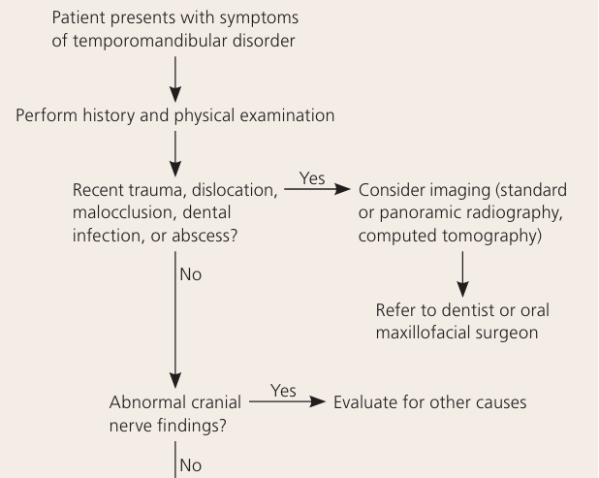
Diagnostic Steps Summary
1️⃣ History
Onset, duration, aggravating factors
History of trauma, bruxism, parafunctional habits
2️⃣ Physical Examination
Mandibular range of motion: Normal = 35-45 mm; <25 mm = dysfunction
Joint sounds: Click (disk displacement), crepitus (osteoarthritis)
Palpation: TMJ tenderness → intra-articular; muscle tenderness → MPDS
Mandibular deviation: Toward affected side = disk displacement
Malocclusion check: Note but not directly diagnostic
Neck & shoulder palpation: Tenderness → MPD
3️⃣ Imaging (if indicated)
Panoramic X-ray
Plain radiography (transcranial and trans-maxillary views)
MRI for disk position
CT for joint degeneration

Slide 7
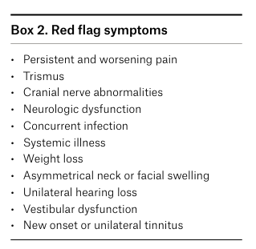
Refer to specialist
Red flag symptoms (severe persistent s/s, neurological/systemic illness)
No obvious etiology
History of trauma or fracture to the TMJ complex
How much time it is reasonable to trial conservative management prior to referral.
- six to eight weeks

Slide 8
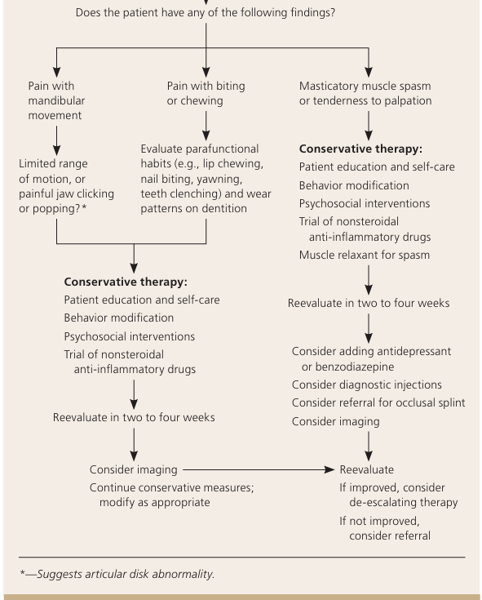
NONPHARMACOLOGIC MANAGEMENT
Patient education and reassurance, jaw rest, a soft diet, warm compress, passive stretching exercises.
Behaviour modifications- stress reduction, sleep hygiene, elimination of parafunctional habits (e.g., teeth grinding, pencil or ice chewing, teeth clenching)
Avoidance of extreme mandibular movement (e.g., excessive opening during yawning, tooth brushing, and flossing).
Nonsteroidal inflammatory drugs (NSAIDs): First-line 10 to 14 days (Naproxen)
Masticatory muscle spasm and chronic bruxism)
Muscle relaxants
Stress/anxiety- (Benzodiazepines): (Tricyclic antidepressants
OCCLUSAL SPLINTS AND ADJUSTMENTS
Patients with severe bruxism and nocturnal clenching.
Occlusal adjustments (i.e., grinding enamel surfaces to improve dentition) have no benefit in the management or prevention of TMD.

Slide 9
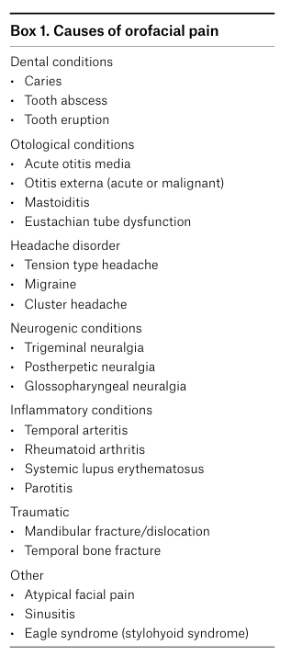
Progress note
Mention that – no obvious dental cause of pain was observed
oral overall health, check dental caries, occlusion was examined, or dental wear patterns that may be contributing to TMD symptoms.
Up to 40% of symptomatic patients have spontaneous resolution of their symptoms without any treatment
50–90% of patients have relief with conservative therapy.

Slide 10
Feature | Internal Derangement / Intra-Articular | Myofascial Pain Dysfunction Syndrome (MPDS) | TMJ Arthritis Inflammation (osteoarthritis, RA, ankylosing spondylitis)
Predisposing factors | Joint injury, hypermobility, inflammatory arthritis | Bruxism, clenching, abnormal posture, stress, fibromyalgia | Autoimmune disease, aging, prior joint trauma
Mandibular Movement | Deviation toward affected side, limited opening (<25 mm in closed lock) | Normal or reduced opening due to muscle pain | Limited motion, stiffness
Joint Sounds | Clicking ; crepitus if progressed | None | Crepitus common
Pain Location | TMJ tenderness, joint pain on loading | Muscle tenderness | TMJ pain, joint line tenderness
Palpation | Tender TMJ, reproducible tenderness | Tender masseter, temporalis, neck muscles | Tender joint with coarse crepitus
Range of Motion | Limited, deviation | Limited due to muscle restriction | Limited by joint degeneration
Other signs | Locking episodes, sudden stop in opening | Headache, referred pain, neck stiffness | Joint stiffness, possible swelling
Psychosocial Factors | Minimal | Significant role: anxiety, depression common | Variable

Slide 11
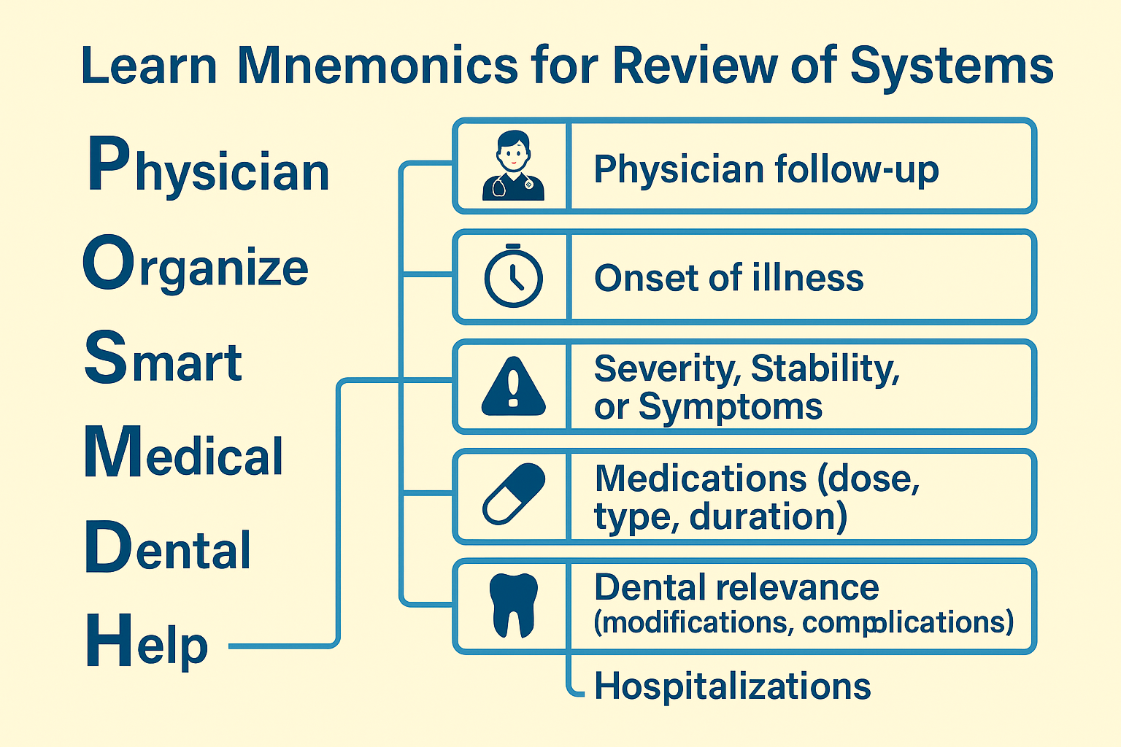

Slide 12
CARDIOVASCULAR DISEASE

Slide 13
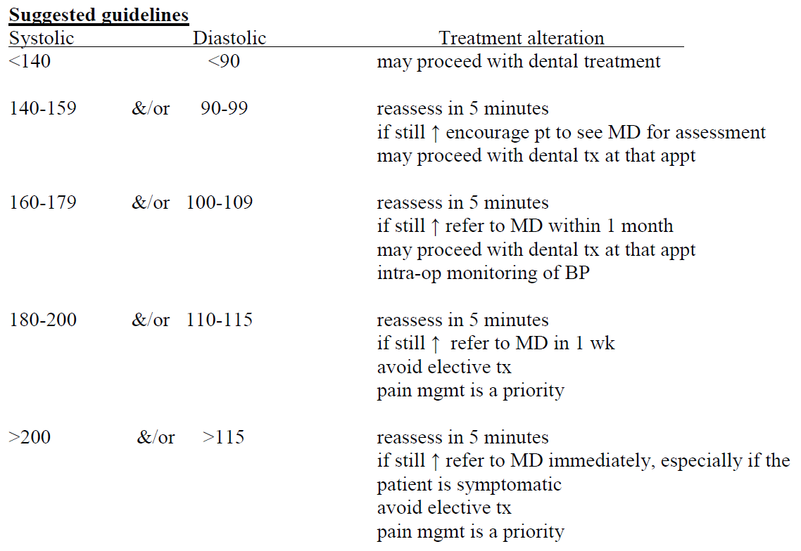
Hypertension
Are you being followed by your MD ? Specialist ?
Is it diagnosed?
How often you check the B.P ?
What symptoms are you currently experiencing?
Treatment· Medication name, dose, frequency

Slide 14
Scenario | Case 1 > 180/110 mm Hg | Case 2 > 180/110 mm Hg Symptomatic (uncontrolled)
Immediate dental care? | Defer elective care; consider temporary measures | Defer all care; medical emergency risk higher
Pain management? | Palliative care (temporary filling, analgesics) | Palliative care only if absolutely needed, very cautiously
Referral? | Refer to physician ASAP | Immediate referral; consider EMS if symptomatic Avoid completely unless life-threatening emergency
Monitoring? | Recheck BP, monitor symptoms | Monitor vitals, prepare for emergency response
Emergency signs? | Watch for headache, dizziness, visual changes, chest pain | Breathlessness + red face = possible hypertensive crisis; activate EMS
Dental setting actions? | Calm environment, short consult, discuss physician follow-up | Stop procedure, emergency protocol, EMS referral

Slide 15
Minimally Competent criteria | STEP 1 | Gather information: Medical History (Review of Systems) Past and current dental history.
 | STEP 2 | Explain the procedure required
 | STEP 3 | Educating the patient about Hypertensive Urgency Referral to the MD immediately. No definitive management until the BP is controlled.
 | STEP 4 | Addressing the concern of the patient: (Pain management) Smoothening of the sharp edges. Topical anesthetic for the tongue ulcer.
 | STEP 5 | Conclusion/Summarized Being organized
Critical error |  | No referral to MD. Definitive Treatment options offered.

Slide 16
ISCHAEMIC HEART DISEASE
onset and Frequency: When did it start? When was the last episode?
H/O Hospitalization?
What triggers the pain? Rest Vs Exercise
What relieves the pain? Does pain go away after taking Nitroglycerine ?
Duration: How long does the pain last?
Does it become worse when you exercise?
List of medications
If Patient has history of chest pain in last dental visit:
Onset: when did it start (type of visit, procedure, stress level, how was it managed)

Slide 17
UNSTABLE ANGINA/RECENT MI (<1 MONTH)
PHYSICIAN REFERRAL :
Angina::Unstable /symptomatic condition.
Attack: increased severity/ Frequency.
Cardiac History:: Any recent hospitalizations or changes in cardiac condition?
Incomplete info regarding Medications
Take consent to refer to physician
Manage any current emergency- analgesic/smoothen sharp edges
Elective dental care should be deferred.
Medical consultation obtained. Delay major surgical procedure for at least 3 months.
Treat them in a hospital facility.
Follow Stress Reduction Protocol.
Patients who are taking warfarin or Direct oral anticoagulants (DOACs) — avoid giving NSAIDS
Use Prophylactic Nitroglycerine just before the procedure.

Slide 18
STABLE ANGINA
Consider these treatment modifications:
Stress Reduction: Short, morning appointment; stress-reducing techniques (calm environment/ preoperative anxiolytics)
Medication Management: Ensure the patient takes their nitroglycerine as prescribed.
Monitoring: Continuously monitor vital signs
Local Anesthesia without or with minimal vasoconstrictors (e.g., epinephrine) to avoid triggering angina.
Pain Control: Use effective pain management to prevent postoperative pain, which can induce stress and angina.
Emergency Preparedness: Oxygen, nitroglycerine, and have emergency protocols in place.
Short appointments in the morning.
Comfortable chair position.
Monitoring vital signs.
Profound local anesthesia.
Reduced stress environment with oral sedation or nitrous oxide–oxygen sedation.
Effective postoperative pain control

Slide 19
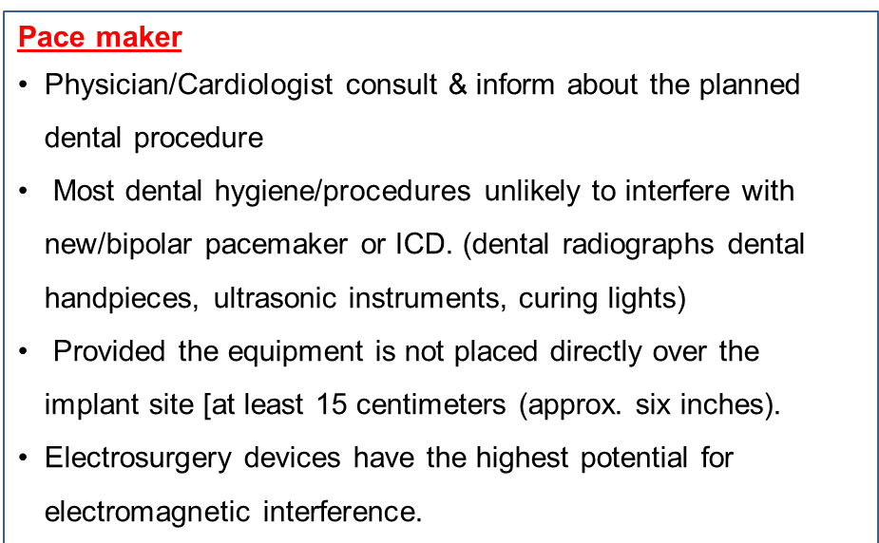
CARDIAC ARRYTHMIA- PACE MAKER
Cardiovascular System:
Have you experienced any recent chest pain/palpitations/shortness of breath?- asked if stable
H/O Hosp.
Has your pacemaker been checked recently, any current issues with it?
Bleeding Risk: asked complication
Have you noticed any unusual bleeding or bruising recently?
Do you experience prolonged bleeding after minor cuts or injuries?
Medications and Allergies:
Are you currently taking any other medications/ supplements/ over-the-counter drugs not mentioned?
Do you have any known allergies,(local anesthetics or antibiotics)?
Oral Health and Dental Concerns: any modifications considered
Have you had any issues with bleeding gums or delayed healing after previous dental procedures?

Slide 20
STEPS
Review of system
Take a thorough medical and dental history, including:
Stent placement date and type (bare-metal vs. drug-eluting)
Cardiologist’s input regarding ongoing dual antiplatelet therapy
Any history of bleeding episodes.
Effects of possible bacteremia on recently stented vessels (30 days)
Risk of post-treatment bleeding
Possibility of interactions with prescribed medications
Patient’s concern
Inquire about the patient’s recent blood. - Platelet count and possibly the bleeding time.
Local measures to minimize bleeding (suturing, hemostatic agents, tranexamic acid rinse)
Prefer minimally traumatic extraction technique
Post-op pain management avoiding NSAIDs (due to bleeding and cardiac risk). Nonsteroidal anti-inflammatory drugs should be avoided in patients who are receiving antiplatelet medications.

Slide 21
Aspect | Pacemaker Surgery | Coronary Stent Placement
Common Medications | - Antiarrhythmics (rarely) - Beta-blockers - Sometimes anticoagulants | - Dual Antiplatelet Therapy (DAPT): → Aspirin → Clopidogrel (or Ticagrelor/Prasugrel) - Statins - Beta-blockers - ACE inhibitors
Dental Concerns | Electromagnetic interference (EMI) (electrosurgery units) Bleeding risk minimal unless on anticoagulants | High bleeding risk due to DAPT Risk of stent thrombosis if antiplatelets are stopped prematurely Coordination with cardiologist essential
Modifications for Extraction | Avoid ultrasonic devices near chest | Minimize trauma Local hemostatic measures (suturing, Surgicel, tranexamic acid rinse) Discuss with cardiologist if DAPT is active and surgery is urgent

Slide 22
Take a thorough medical and dental history, including:
Stroke type and severity
Any recent hospitalizations or medication changes
Current neurological status (speech, swallowing, motor function)- discuss questinaaire.
Risk of bleeding
Any history of post-stroke seizures or anticoagulant use
Employ atraumatic extraction technique
Use local hemostatic measures
Stress Reduction Protocol for stable patients.
Post-op pain control with acetaminophen (avoid NSAIDs due to bleeding risk)
Assess for cognitive impairment

Slide 23
Patient Management
Defer elective dental treatment for at least 1 month following a stroke.
If pain management is necessary, perform under a hospital setting.
Aspect | Consideration
Bleeding risk | High due to dual antiplatelet therapy (DAPT)
Medical clearance | Recommended if recent stroke or unstable
Stress management | Short, calm appointments; avoid treatment if uncontrolled hypertension
Chair positioning | Upright to semi-reclined if dizziness or dysphagia present
Follow-up | Close monitoring for post-op bleeding

Slide 24
Dental Management of Congestive Heart Failure
Stress reduction Protocol
If patient is taking Digoxin, avoid the use of NSAIDS, its life threatening.
Concurrent use of ABL(ACE inhibitors, loop diuretics or beta-blockers), (avoid NSAIDs or limit use to ≤4 days)
For patients with symptoms of untreated/uncontrolled heart failure, defer elective treatment and refer to physician

Slide 25
Take a thorough medical and dental history, including:
Assess stability of patient
Assess bleeding risk of patient
No discontinuation of Aspirin or Clopidogrel without neurologist’s clearance
Plan minimally invasive surgical technique
Employ atraumatic extraction technique
Use local hemostatic measures (e.g., pressure packs, suturing, tranexamic acid rinse, gelatin sponge)
Stress Reduction Protocol for stable patients.
Post-op pain control with acetaminophen (avoid NSAIDs due to bleeding risk)
Provide written and verbal post-op instructions for how to manage bleeding if appeared after surgery

Slide 26
Joint Replacement
Mainly concerned with major joint replacements (usually knees and hip)
How often do you follow up?
Which joint was replaced?
When was the surgery done?
Any complications due to treatment? Hematoma? Wound drainage?
Were you advised to take antibiotics prior to dental treatments? If yes, who recommended it? And when did you last take antibiotic prophylaxis?
IS THERE ANY COMPLOICATION/INFECTION with your prosthetic joint?

Slide 27
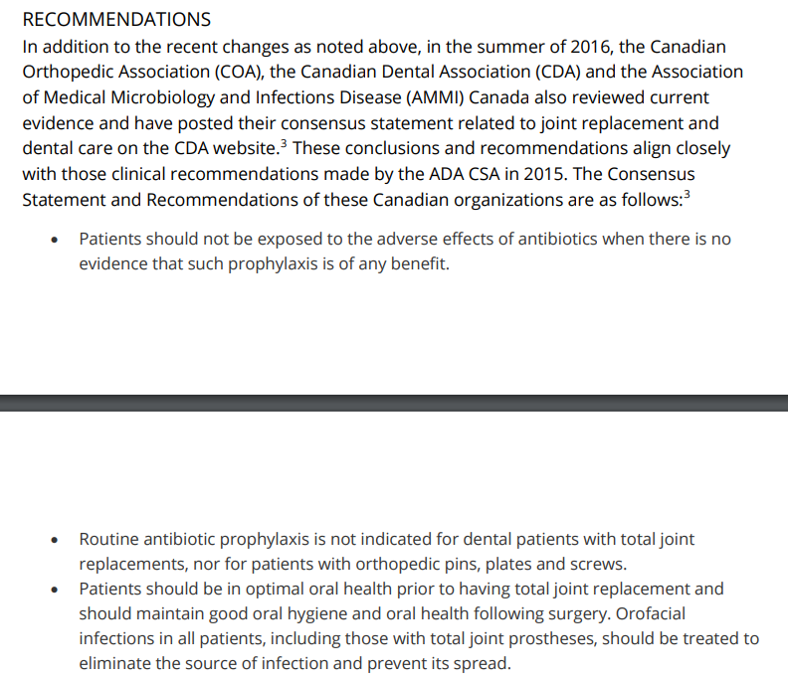
Dental Management for Joint Replacement
Follow current guidelines of RCDSO and CDA. American heart association
Do a medical consult to discuss antibiotic use if required
If complications after joint replacement: discussion is needed with Orthopaedic surgeon.
If antibiotics are recommended by MD:
(a) Then MD should prescribe the antibiotics.
(b) MD should advise what procedures antibiotics are recommended for.
(c) MD should decide which antibiotic should be used.

Slide 28
No antibiotic prophylaxis required
Mitral valve prolapse
Congenital heart disease
Rheumatic heart disease
Stent placed in heart
Pacemaker

Slide 29
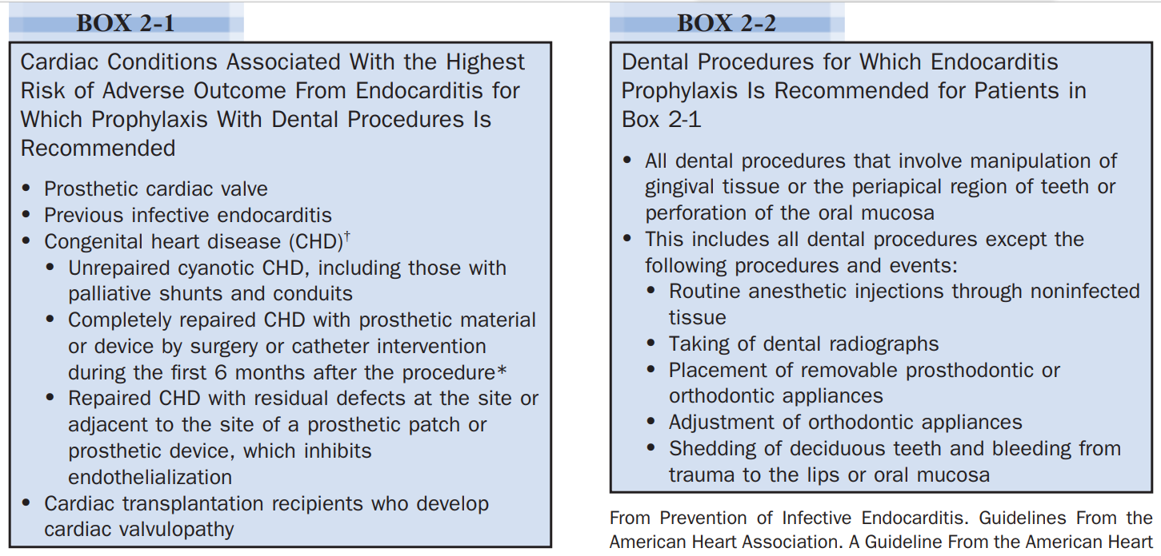
CURRENT AMERICAN HEART ASSOCIATION RECOMMENDATIONS (2007)

Slide 30
Asthma

Slide 31

Questions to ask for history of Asthma
Are you being followed by your MD? or specialist?
What type of attack do you usually have? Symptoms: wheezing? coughing?
When was it diagnosed?
How often do you get the attacks? What usually causes the attacks? Weather? Anxiety? Stress?
Any history of hospitalization ? If yes, how many hospitalization records? When was the last visit? How long did you have to stay in the hospital ?
When was the last asthma attack?
Treatment: Medication name, route, dose, frequency ?

Slide 32
Dental Management
Continue with usual medications and bring inhalers prior to appointment.
Avoid known triggers of asthma.
Stress reduction protocol.
Schedule the patients when attacks are least likely (short morning).
Semi supine or upright chair position for treatment may be better tolerated.
Monitor vitals
Adequate anaethesia
Postoperative pain control
Preoperative and intraoperative sedation may be desirable. If sedation is required, nitrous oxide–oxygen inhalation is best. Benzodiazepines can be given short term for well controlled cases.
Narcotics (opioids) and barbiturates are avoided in severe asthma.
Avoid ASA in all patients with asthma, avoid NSAIDS only in persistent cases.
Avoid NSAIDS with ASA induced asthma and nasal polyps.
Active Asthma: Delay routine treatment and treat in a hospital setting until asthma is well controlled.

Slide 33
Pregnancy
Type of treatment procedure
Trimester?
Complications in previous or current pregnancy?

Slide 34
Dental Management of Pregnant patient
Delay routine treatment in 1st Trimester and delay all elective surgery until delivery.
Minimize radiographic exposure.
Scheduling short morning appointments, allowing the patient to assume a semi reclined left lateral position.
Avoid: ASA , Anxiolytic drugs, Tetracyclines throughout pregnancy.
Avoid Nitrous oxide in 1st trimester but can give in 3rd trimester provided its 50 % O2.
Avoid NSAIDs in third trimester, can be given in 1st and 2nd trimesters (Ibuprofen). Avoid Opioids in 1st and 2nd Trimesters.

Slide 35
THANK YOU
SEE YOU IN SESSIONS

Slide 36
Date | Day | Time (EST) | Session
13 Jul 2025 | Sunday | 9:30 AM – 11:30 AM | Introduction to the Program
17 Jul 2025 | Thursday | 9:00 AM – 11:00 AM | Session 1: Patient-Centered Care: Review of Systems & Medical Management
20 Jul 2025 | Sunday | 9:30 AM – 11:30 AM | Session 2: Patient-Centered Care: Treatment Plans & Problem List
24 Jul 2025 | Thursday | 9:00 AM – 11:00 AM | Session 3: Patient-Centered Care: Approach to a Case – Options & Management
27 Jul 2025 | Sunday | 9:30 AM – 11:30 AM | Session 4: Communication: Informed Consent and Basic Communication Strategies
31 Jul 2025 | Thursday | 9:00 AM – 11:00 AM | Session 5: Communication: Referrals and Special Cases
03 Aug 2025 | Sunday | 9:30 AM – 11:30 AM | Session 6: REVISE & PRACTICE
07 Aug 2025 | Thursday | 9:00 AM – 11:00 AM | Session 7: Health Promotion: Risk Assessment & Preventive Dentistry
10 Aug 2025 | Sunday | 9:30 AM – 11:30 AM | Session 8: Health Promotion: Public Health & Access to Care
14 Aug 2025 | Thursday | 9:00 AM – 11:00 AM | Session 9: Professionalism: Professional Boundaries and Communication
17 Aug 2025 | Sunday | 9:30 AM – 11:30 AM | Session 10: Professionalism: Accountability and Legal Obligations
21 Aug 2025 | Thursday | 9:00 AM – 11:00 AM | Session 11: Practice and Info Mgmt: Clinical Recordkeeping & Documentation
24 Aug 2025 | Sunday | 9:30 AM – 11:30 AM | Session 12: Practice and Info Mgmt: Safe, Ethical Dental Practice Mgmt

Slide 37
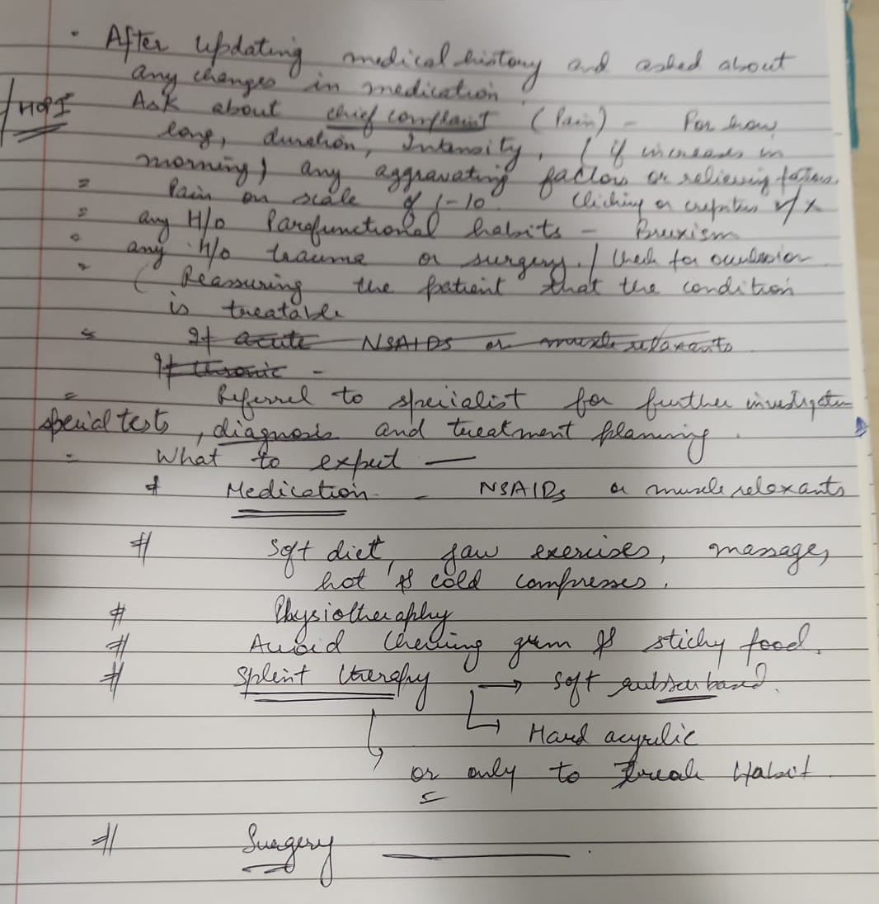
Organize and make it more cohesive under headings
Q: Patient is diagnosed with Temporomandibular disorder,
manage the case.
General comments:
Start with small introduction with respect to case given.
Organize under small subheadings
BE CONCISE
Do not wrote everything in pointers- use pointers to highlight.
Overall viewpoint for management
Management is divided into two types- Conservative- Pharmacological and non-pharmacological; Non-conservative
Another way is to write Short term management to control symptoms and Long term management which may include TMJ specialist.

Slide 38
Introduction: Start with that given case patient is suspected to have Temporomandibular disorder,
BE CONCISE: Enquire about the current sign and symptoms – pain, deviation of the jaw, headaches, any limitation of mouth opening or neck and shoulder pain. If there is any history of trauma/accident. Any past medical history- osteoarthritis/ another joint issues. Any stress, depression/ anxiety, parafunctional habits like clenching and bruxism.
Thorough examination and history of patient should be taken. Imaging may include Special TMJ scans, CT/ MRI
As TMD is complex, thorough assessment is essential to :
Find and targeting the possible etiology
Assessing severity of disease
Reaching specific diagnosis as TMD is an umbrella term.
As a general dentist, we have limitations so we need to refer patient to TMJ specialist to perform complete assessment and manage the disorder. I will explain to patient that for Long term management of current condition I will refer him to TMJ specialist. He might do further assessment and scans for jaw joint. He may consider some bite splints, may prescribe muscle relaxant, and steroids. If this conservative treatment fails, the specialist may consider surgical intervention.
Not required
Be Concise
Good.
Do not write one word

